Slide 1
Good Software Takes 10 Years
Presented by Mychael Cress

Slide 2
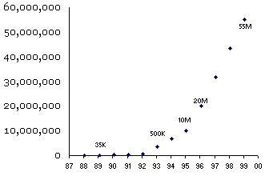
Lotus Notes
Development started in 1984
Version 1.0 released in 1989
10 years later, grew rapidly

Slide 3
6 Common Mistakes
Get Big Fast Syndrome
Overhype
Believing in Internet Time
Not getting upgrade revenues
"We'll Ship It When It's Ready“ syndrome
Updating too frequently

Slide 4
Get Big Fast Syndrome
Attempting to grow too fast early on
Amazon model from Phillip’s presentation
desktop.com
  Overstaffed
  Built to sell
  Version 1.0 was awful

Slide 5
Overhype
People will be underwhelmed with early versions and be turned off of the software
Don’t try to make your software out to be something that it’s not.

Slide 6
Believing in Internet Time
Believing that business moves faster on The Internet
Software often gets released faster than physical things
Leads to the belief that it gets made faster
Netscape vs. Internet Explorer

Slide 7
Not getting upgrade revenues
Producing a product, selling it, and then stopping
Can cause a business to run out of money between versions
Solutions are higher upgrade fees or monthly/yearly fees

Slide 8
We'll Ship It When It's Ready
Don’t try to include every feature in version 1.0
Start with basic features and expand
Allows time for feedback
Microsoft Word

Slide 9
Updating too frequently
Easy to do early on when adding features
Difficult once all features are implemented
Customers will skip releases if they don’t see anything worthwhile

Slide 10
In closing
If your business plans on producing quality software, it needs to plan on committing to it
Don’t expect your first release to be perfect and sweep the market

Slide 11
References
http://www.joelonsoftware.com/articles/fog0000000017.html
http://www.joelonsoftware.com/articles/fog0000000056.html

Slide 12
Questions?

